Slide 1
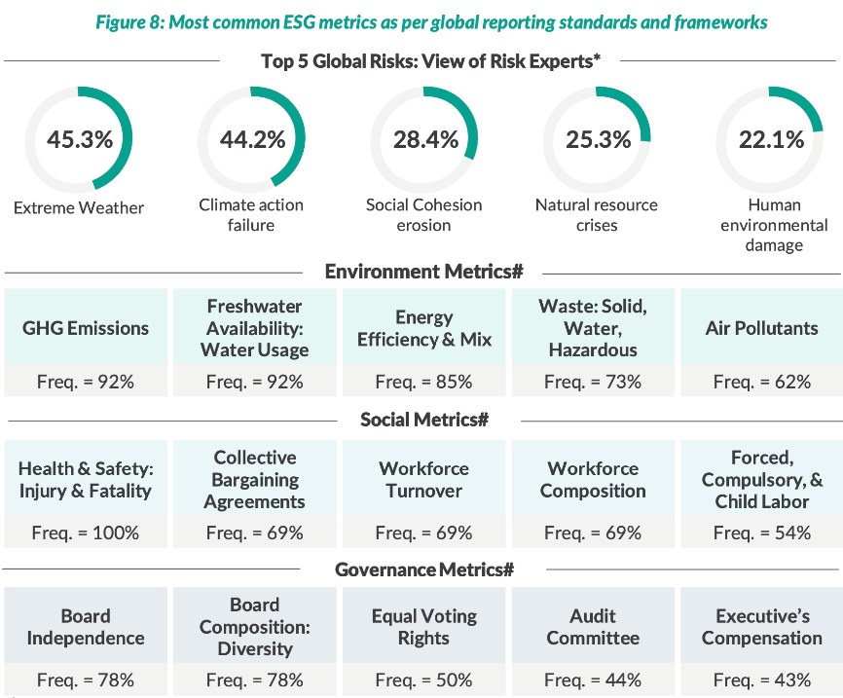
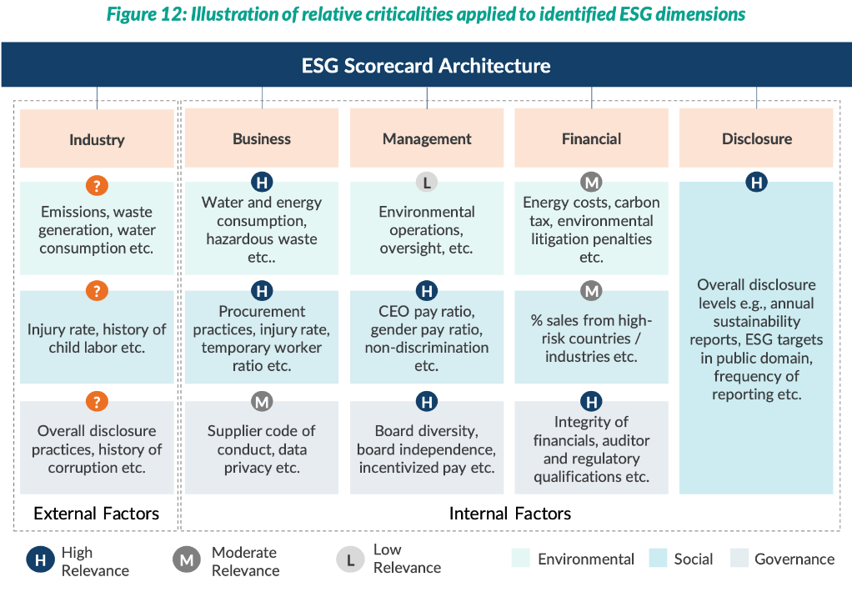
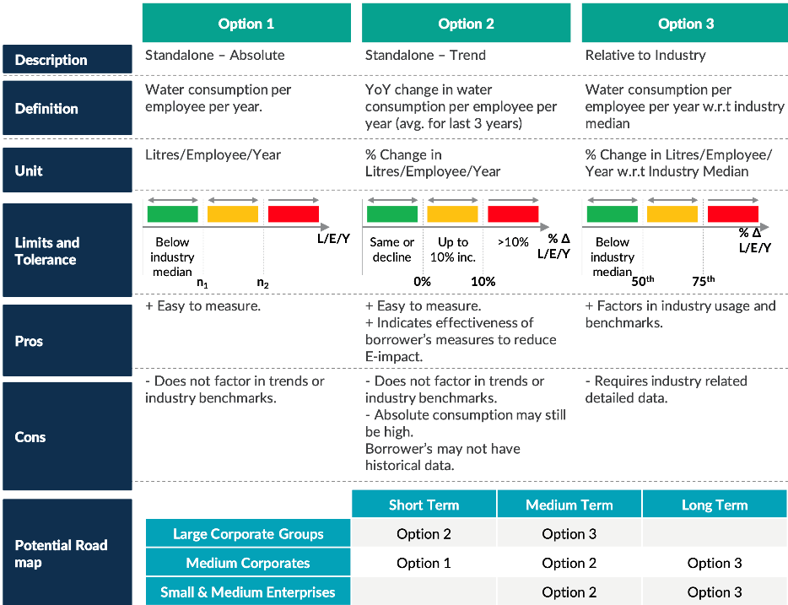
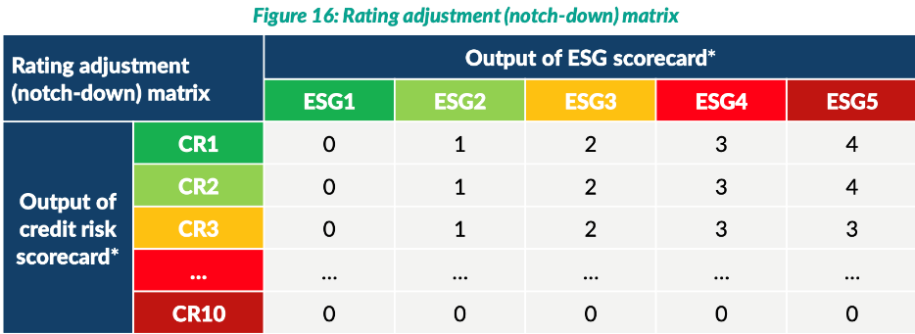
Sustainability Use Case 1: Competitor Analysis
Steps
Identify relevant and prepare a library of ESG
metrics
b. Assign relative criticalities(weights) to metrics
c. Define units, limits and tolerances
d. Mechanism for scoring and integration with credit decision-making

Slide 2
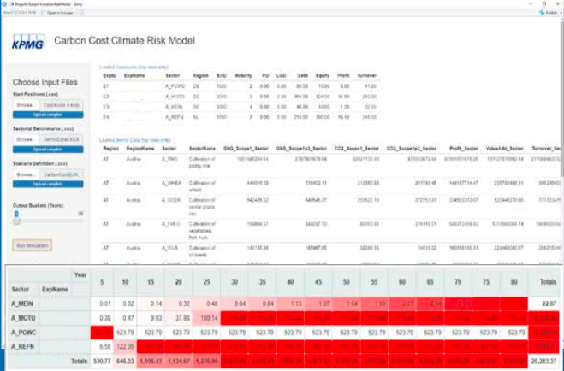
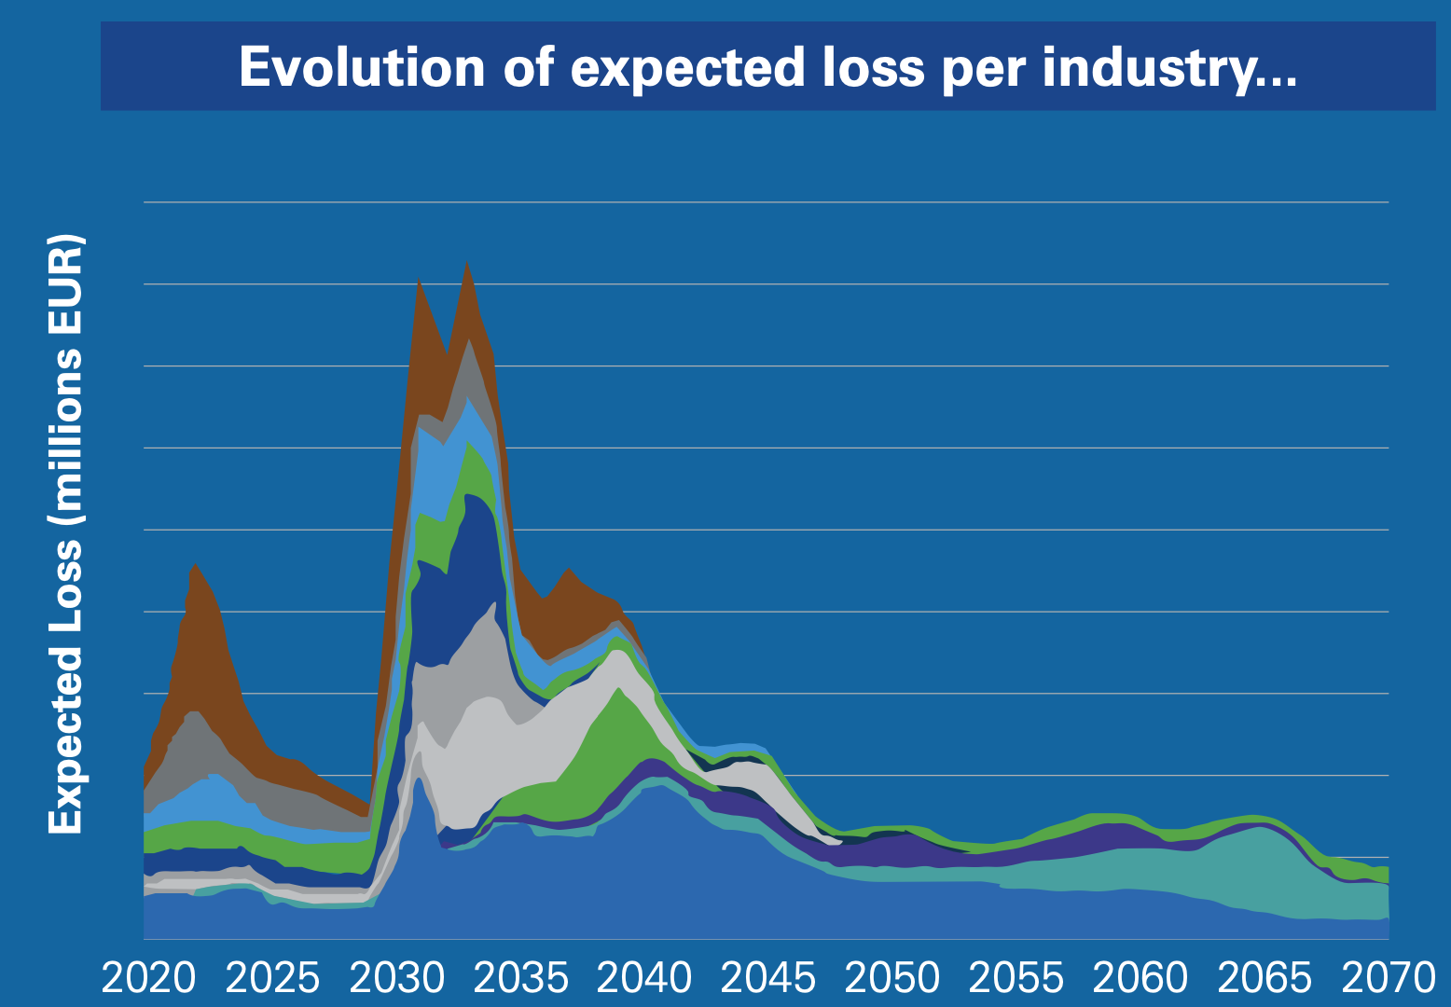
Sustainability Use Case 2: KPMG
Minimum Viable Prototype
KPMG: Transition risk scenario analysis – focusing on impact of carbon cost on credit loss
1. Financial impact at borrower level is determined via linking carbon footprint and evolution of carbon cost.
2. Stressed PDs are generated and integrated based on simulated financials.
3. Additional credit losses are being calculated from transition risk assuming prolongations are adequately
priced at time of prolongation.
The prototype indicates the impact on corporate portfolios by presenting the evolution of the expected loss
per industry. A summary of quantitative results can be used to communicate climate sensitivity of business
within the organization, up to management board level.
KPMG’s climate risk stress testing prototype integrates three elements
Client data: Bank’s loan portfolio (individual loans; credit risk properties; financials of borrower)
Sector information: Carbon footprint
Scenario: Evolution of Carbon Cost
Other current tools:
a. ESG risk tool – a qualitative credit portfolio analysis tool that functions as the basis for further analysis, risk mitigation and implementation
b. Climate IQ – a multi-industry risk management tool that evaluates key KPIs to assess a company’s exposure to climate change (both physical and transition risks)
c. ESG Stress Testing Solution
Prediction of expected credit loss for different
industry sectors
https://kpmg.com/dp/en/home/insights/2021/05/esg-risks-in-banks.html

Slide 3
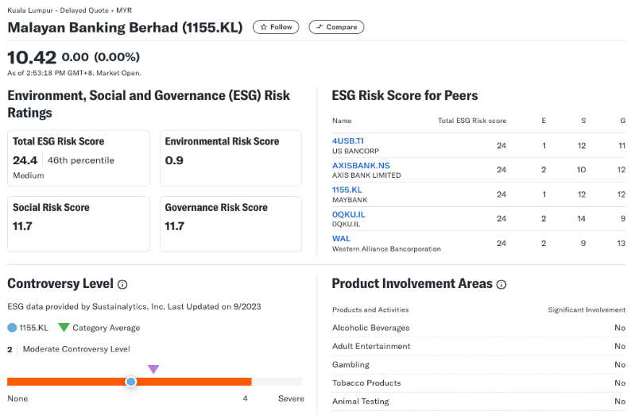
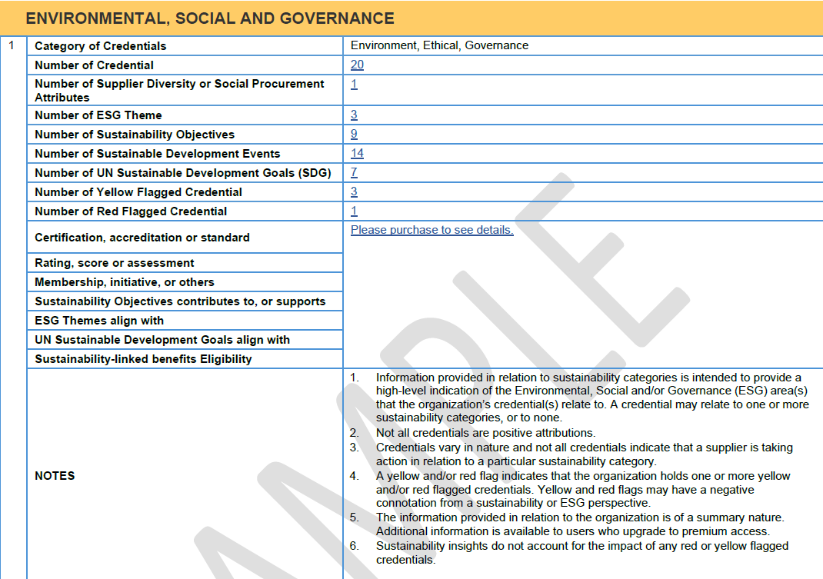
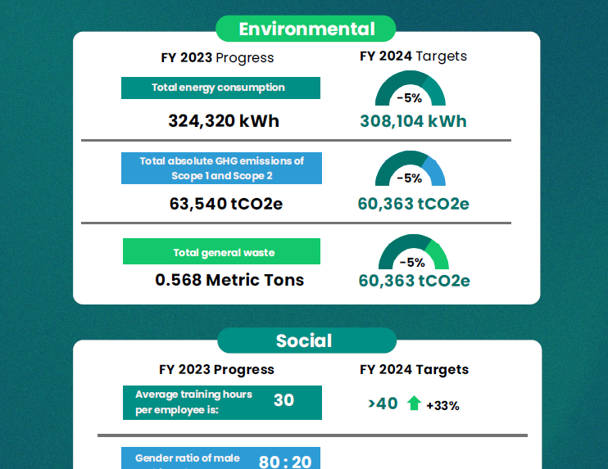
Summary of Identified ESG Data
Yahoo Finance
Experian ESG
ESGpedia
Data Depth
Utilizes Morningstar Sustainability Rating, which assesses company’s ESG performance based on data from Sustainalytics, giving a score relative to its industry peers.
Based on certification, accreditation or standard. Rating, score and assessment based on credentials, such as Sustainalytics ESG Risk Rating and UN Sustainable Development Goals. No transparency to how ratings are derived.
Environmental: Climate-related data, GHG Emissions. Social: Diversity and Equal opportunity, Employment, Occupational Health & Safety, Development & Training, Child & Forced Labor. Governance: Board Composition, Anti-Corruption
Coverage
Public-listed companies
TBC
Private & Public
Description
Basic ESG Scores. Provides snapshot of sustainability risks i.e. Total ESG Risk score, a controversy level indicating reputational risks, and peer comparison to benchmark performance
Centralized ESG summary reports from various ESG data sources. Provides ESG data extraction services where client can provide list of companies, and Experian return the ESG details of the company. All reports available in digital form, embedded into current Experian reports
Comprehensive ESG reports with comprehensive sustainability data, and supply chain ESG insights
Cost
Free, Website/API
Paid (TBC)
In-house
Data Frequency
Periodic updates
Regular updates
On report basis (at point of application)

